Slide 1
An Introduction to Processor Design
Veena.G.S.
IV A section

Slide 2
Processor architecture and organization
All modern general-purpose computers employ the principles of the stored-program digital computer.
Computer architecture describes the user's view of the computer. The instruction set, visible registers, memory management table structures and exception handling model are all part of the architecture.

Slide 3
Processor architecture and organization
Computer organization describes the user-invisible implementation of the architecture. The pipeline structure, transparent cache, table-walking hardware and translation look-aside buffer are all aspects of the organization.
A general-purpose processor is a finite-state automaton that executes instructions held in a memory. The state of the system is defined by the values held in the memory locations together with the values held in certain registers within the processor itself

Slide 4
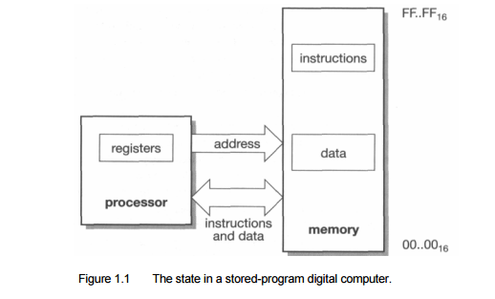
stored-program digital computer.

Slide 5
Stored Program Concepts
The idea was introduced in the late 1940s by John von Neumann, who proposed that a program be electronically stored in binary-number format in a memory device so that instructions could be modified by the computer as determined by intermediate computational results.
A CPU chip can handle billions of instructions per second, and as long as the instructions are valid and reference data within the program's boundaries, the control unit executes them. If not, the computer stops running the program

Slide 6
Stored Program Concepts
Stored program concept Von Neumann Architecture → also known as the Von Neumann model, the computer consisted of a CPU, memory and I/O devices.
The program is stored in the memory. The CPU fetches an instruction from the memory at a time and executes it.
Thus, the instructions are executed sequentially which is a slow process. Neumann m/c are called control flow computer because instruction are executed sequentially as controlled by a program counter.
To increase the speed, parallel processing of computer have been developed in which serial CPU’s are connected in parallel to solve a problem. Even in parallel computers, the basic building blocks are Neumann processors

Slide 7
Stored Program Concepts
Stored program concept :An accumulator is a register for short-term, intermediate storage of arithmetic and logic data in a computer's CPU (central processing unit).
Stored program concept Memory The computer will have memory that can hold both data and also the program processing that data. In modern computers this memory is RAM.
Control Unit :The control unit will manage the process of moving data and program into and out of memory and also deal with carrying out (executing) program instructions - one at a time.
This includes the idea of a 'register' to hold intermediate values. In the illustration above, the 'accumulator' is one such register.
The 'one-at-a-time' phrase means that the von neumann architecture is a sequential processing machine.
Input - Output This architecture allows for the idea that a person needs to interact with the machine. Whatever values that are passed to and forth are stored once again in some internal registers.

Slide 8
stored-program digital computer.
The Stored- The stored-program digital computer keeps its instructions and data in the same program memory system, allowing the instructions to be treated as data when necessary.
This Computer enables the processor itself to generate instructions which it can subsequently execute.
Although programs that do this at a fine granularity (self-modifying code) are generally considered bad form these days since they are very difficult to debug, use at a coarser granularity is fundamental to the way most computers operate.
Whenever a computer loads in a new program from disk (overwriting an old program) and then executes it the computer is employing this ability to change its own program

Slide 9
stored-program digital computer.
In the stored program concept, both the instructions and the data (that the instructions operate on) are stored in the computer memory itself. Before the introduction of this idea, instructions and data were considered two totally different entities and were thus stored separately.
Thus instructions like data can be read from the memory and written to the memory by the processor.
The processor then addresses the memory, reads the corresponding instructions, executes them and according to the executed instruction, processes (reads and writes) data as well.
Computers that store both instructions and data on the same memory are said to be based on the Von Neumann architecture. Modern desktop computers are still based on the same stored program concept.

Slide 10
Abstraction in hardware design
Computers are very complex pieces of equipment that operate at very high speeds.
A modern microprocessor may Abstraction in hardware design
be built from several million transistors each of which can switch a hundred million times a second.
on a desktop PC or workstation and try to imagine how a hundred million million transistor switching actions are used in each second of that movement.

Slide 11
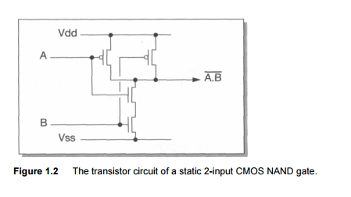
Abstraction in hardware design

Slide 12
Abstraction in hardware design
Now consider that every one of those switching actions is, in some sense, the consequence of a deliberate design decision.
None of them is random or uncontrolled; indeed, a single error amongst those transitions is likely to cause the machine to collapse into a useless state.
How can such complex systems be designed to operate so reliably? Transistors A clue to the answer may be found in the question itself.
We have described the operation of the computer in terms of transistors, but what is a transistor? It is a curious structure composed from carefully chosen chemical substances with complex electrical properties that can only be understood by reference to the theory of quantum mechanics, where strange subatomic particles sometimes behave like waves and can only be described in terms of probabilities

Slide 13
Abstraction in hardware design
Yet the gross behaviour of a transistor can be described, without reference to quantum mechanics, as a set of equations that relate the voltages on its terminals to the current that flows though it.
These equations abstract the essential behaviour of the device from its underlying physics.
Logic gates The equations that describe the behaviour of a transistor are still fairly complex.
When a group of transistors is wired together in a particular structure, such as the CMOS (Complementary Metal Oxide Semiconductor) NAND gate shown in Figure 1.2, the behaviour of the group has a particularly simple description.
If each of the input wires (A and B) is held at a voltage which is either near to Vdd or near to Vss, the output will will also be near to Vdd or Vss according to the following rules:
• If A and B are both near to Vdd, the output will be near to Vss.
• If either A or B (or both) is near to Vss, the output will be near to Vdd.

Slide 14
Abstraction in hardware design
Logic symbol Truth table The gate abstraction Although there is a lot of engineering design involved in turning four transistors into a reliable implementation of this equation, it can be done with sufficient reliability that the logic designer can think almost exclusively in terms of logic gates. The concepts that the logic designer works with are illustrated in Figure 1.3, and consist of the following 'views' of the logic gate:
• A logic symbol. This is a symbol that represents a NAND gate function in a circuit schematic; there are similar symbols for other logic gates (for instance, removing the bubble from the output leaves an AND gate which generates the opposite output function; further examples are given in 'Appendix: Computer Logic' on page 399).
• A truth table. This describes the logic function of the gate, and encompasses everything that the logic designer needs to know about the gate for most purposes. The significance here is that it is a lot simpler than four sets of transistor equations. (In this truth table we have represented 'true' by '1' and 'false' by '0', as is common practice when dealing with Boolean variables.)

Slide 15
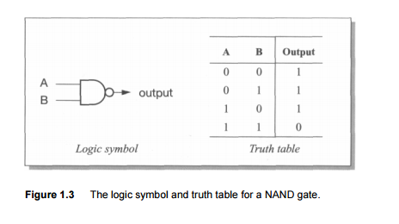
Abstraction in hardware design(The Gate Level Abstraction

Slide 16
Levels of abstraction Gate-level design
Levels of abstraction Gate-level design removes the need to know that the gate is built from transistors.
A logic circuit should have the same logical behaviour whether the gates are implemented using field-effect transistors (the transistors that are available on a CMOS process), bipolar transistors, electrical relays, fluid logic or any other form of logic.
The implementation technology will affect the performance of the circuit, but it should have no effect on its function. It is the duty of the transistor-level circuit designer to support the gate abstraction as near perfectly as is possible in order to isolate the logic circuit designer from the need to understand the transistor equations.
It may appear that this point is being somewhat laboured, particularly to those readers who have worked with logic gates for many years.

Slide 17
Levels of abstraction Gate-level design
However, the principle that is illustrated in the gate level abstraction is repeated many times at different levels in computer science and is absolutely fundamental to the process which we began considering at the start of this section, which is the management of complexity.
The process of gathering together a few components at one level to extract their essential joint behaviour and hide all the unnecessary detail at the next level enables us to scale orders of complexity in a few steps.

Slide 18
A typical hierarchy of abstraction at the hardware level might be:
A typical hierarchy of abstraction at the hardware level might be:
1. transistors;
2. logic gates, memory cells, special circuits;
3. single-bit adders, multiplexers, decoders, flip-flops;
4. word-wide adders, multiplexers, decoders, registers, buses;
5. ALUs (Arithmetic-Logic Units), barrel shifters, register banks, memory blocks;
6. processor, cache and memory management organizations;
7. processors, peripheral cells, cache memories, memory management units;
8. integrated system chips;
9. printed circuit boards;
10. mobile telephones, PCs, engine controllers

Slide 19
Register Transfer Level Design
The next step is to determine exactly the control signals that are required to cause the datapath to carry out the full set of operations.
We assume that all the registers change state on the falling edge of the input clock, and where necessary have control signals that may be used to prevent them from changing on a particular clock edge.
The PC, for example, will change at the end of a clock cycle where PCce is ' 1' but will not change when PCce is '0'.

Slide 20
Register Transfer Level Design
A suitable register organization is shown in Figure 1.6 on page 11.
This shows enables on all of the
Registers,
Function select lines to the ALU (the precise number and interpretation to be determined later),
The select control lines for two multiplexers,
the control for a tri-state driver to send the ACC value to memory and memory request (MEMrq) and read/write (RnW) control lines.
The other signals shown are outputs from the datapath to the control logic, including the opcode bits and signals indicating whether ACC is zero or negative which control the respective conditional jump instructions

Slide 21
Control Logic
The control logic simply has to decode the current instruction
generate the appropriate levels on the datapath control signals, using the control inputs from the datapath where necessary.
The implementation requires only two states, 'fetch' and 'execute', and one bit of state (Ex/ft) is therefore sufficient.

Slide 22
Control Logic
Figure MU0 register transfer level organization.

Slide 23
MU0 control logic.

Slide 24
Control Logic
A quick scrutiny of Table reveals a few easy simplifications.
The program counter and instruction register clock enables (PCce and IRce) are always the same.
This makes sense, since whenever a new instruction is being fetched the ALU is computing the next program counter value, and this should be latched too.
Therefore these control signals may be merged into one.
Similarly, whenever the accumulator is driving the data bus (ACCoe is high) the memory should perform a write operation (Rn W) is low), so one of these signals can be generated from the other using an inverter.

Slide 25
Control Logic
The ALU functions that are required,There are five of them
(A + B, A — B, B, B + 1,0), the last of which is only used while reset is active. Therefore
the reset signal can control this function directly and the control logic need only
generate a 2-bit function select code to choose between the other four. If the principal
ALU inputs are the A and B operands, all the functions may be produced by augmenting a conventional binary adder:

Slide 26
Control Logic
A + B is the normal adder output (assuming that the carry-in is zero).
A — B may be implemented as A + B + 1, requiring the B inputs to be inverted and the carry-in to be forced to a one.
B is implemented by forcing the A inputs and the carry-in to zero.
B + 1 is implemented by forcing A to zero and the carry-in to one.

Slide 27
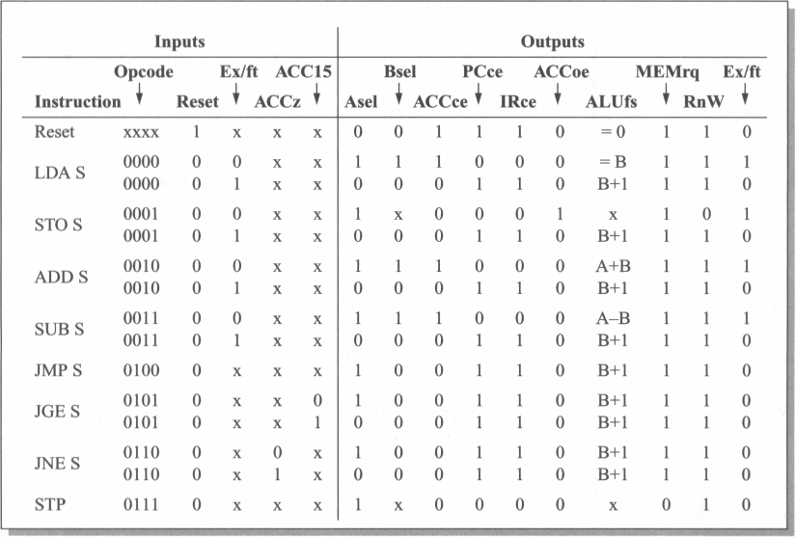
MU0 control logic.

Slide 28
Instruction set design
4-address format:This format requires 4n +f bits per instruction where each
operand requires n bits and the opcode that specifies 'ADD' requires/fbits.

Slide 29
3-address format
3-addressThe first way to reduce the number of bits required for each instruction is to make instructions the address of the next instruction implicit (except for branch instructions, whose role is to modify the instruction sequence explicitly).
Figure A 3-address instruction format.

Slide 30
2-Address format
2-address: A further saving in the number of bits required to store an instruction can be instructions achieved by making the destination register the same as one of the source registers.

Slide 31
1-Address Instructions
1-address instructions
If the destination register is made implicit it is often called the accumulator (see,
for example, MU0 in the previous section); an instruction need only specify one operand:
ADD s1 ; accumulator := accumulator + s1

Slide 32
0-address Instructions
0-address instructions
Finally, an architecture may make all operand references implicit by using an evaluation stack.
The assembly language format is:
ADD ; top_of_stack := top_of_stack +
next_on_stack

Slide 33
Instruction types
A general-purpose instruction set can be expected to include instructions in the following categories:
Data processing instructions such as add, subtract and multiply.
Data movement instructions that copy data from one place in memory to another, or from memory to the processor's registers, and so on.
Control flow instructions that switch execution from one part of the program to another, possibly depending on data values.
Special instructions to control the processor's execution state, for instance to switch into a privileged mode to carry out an operating system function.

Slide 34
Orthogonal Instructions
An instruction set is said to be orthogonal if each choice in the building of an instruction is independent of the other choices.
orthogonal instruction set (architecture):An instruction set where all (or most)instructions have the same format and all registers and addressing modes can be used interchangeably - the choices of op code, register, and addressing mode are mutually independent (looselyspeaking, the choices are "orthogonal").
This contrasts with some early Intel microprocessors where only certain registers could be used by certain instructions.

Slide 35
Orthogonal Instructions
an orthogonal instruction set is an instruction set architecture where all instruction types can use all addressing modes. It is "orthogonal" in the sense that the instructiontype and the addressing mode vary independently.‎Orthogonality in practice · ‎The PDP-11 · ‎The VAX-11 · ‎The MC68000

Slide 36
Addressing modes
Immediate addressing: the desired value is presented as a binary value in the instruction.
MOV AL, 35H (move the data 35H into AL register)
2. Absolute addressing: the instruction contains the full binary address of the desired value in memory.
LDA R0,=0x20000000
3. . Indirect addressing: the instruction contains the binary address of a memory location that contains the binary address of the desired value.
int temp = *x;
Here temp is assigned the value of int type stored at the address contained in X

Slide 37
Addressing Modes
4. Register addressing: the desired value is in a register, and the instruction contains the register number.
MOV AX,CX (move the contents of CX register to AX register)
5. Register indirect addressing: the instruction contains the number of a register which contains the address of the value in memory.
MOV AX, [BX](move the contents of memory location s addressed by the register BX to the register AX)
6. Base plus offset addressing: the instruction specifies a register (the base) and a binary offset to be added to the base to form the memory address.
MOV AL,[BX+05]

Slide 38
Addressing modes
ADD AX, [BX+SI]
7. Base plus index addressing: the instruction specifies a base register and another register (the index) which is added to the base to form the memory address.
ADD AX, [BX+SI]
8. Base plus scaled index addressing: as above, but the index is multiplied by a constant (usually the size of the data item, and usually a power of two) before being
added to the base.
Base + (Index * Scale)
9. Stack addressing: an implicit or specified register (the stack pointer) points to an area of memory (the stack) where data items are written (pushed) or read (popped) on a last-in-first-out basis.

Slide 39

Control flow instructions
Where the program must deviate from the default (normally sequential) instruction sequence, a control flow instruction is used to modify the program counter (PC) explicitly.
The simplest such instructions are usually called 'branches' or 'jumps'. Since most branches require a relatively short range, a common form is the 'PC-relative' branch.
A typical assembly language format is:

Slide 40
Continued..
Here the assembler works out the displacement which must be added to the value the PC has when the branch is executed in order to force the PC to point to LABEL.
Conditional branches:Some processors (including MU0) allow the values in the general registers to control whether or not a branch is taken through instructions such as:
• Branch if a particular register is zero (or not zero, or negative, and so on).
• Branch if two specified registers are equal (or not equal).

Slide 41
Subroutine calls
Sometimes a branch is executed to call a subprogram where the instruction sequence should return to the calling sequence when the subprogram terminates.
Since the subprogram may be called from many different places, a record of the calling address must be kept.
There are many different ways to achieve this:
The calling routine could compute a suitable return address and put it in a standard memory location for use by the subprogram as a return address before executing the branch.
• The return address could be pushed onto a stack.
• The return address could be placed in a register.

Slide 42
System Calls
Another category of control flow instruction is the system call. This is a branch to
an operating system routine, often associated with a change in the privilege level of the executing program.
Some functions in the processor, possibly including all the input and output peripherals, are protected from access by user code.
Therefore a user program that needs to access these functions must make a system call.
System calls pass through protection barriers in a controlled way.
A well-designed processor will ensure that it is possible to write a multi-user operating system where one user's program is protected from assaults from other, possibly malicious, users.
This requires that a malicious user cannot change the system code and, when access to protected functions is required, the system code must make thorough checks that the requested function is authorized.

Slide 43
Exceptions
The final category of control flow instruction comprises cases where the change in the flow of control is not the primary intent of the programmer but is a consequence of some unexpected (and possibly unwanted) side-effect of the program.
An attempt to access a memory location may fail, for instance, because a fault is detected in the memory subsystem.
The program must therefore deviate from its planned course in order to attempt to recover from the problem.
Try and Catch blocks helps with the solution

Slide 44
Processor design trade-offs
The art of processor design is to define an instruction set that supports the functions that are useful to the programmer whilst allowing an implementation that is as efficient as possible.
Preferably, the same instruction set should also allow future, more sophisticated implementations to be equally efficient.

Slide 45
Processor design trade-offs
The programmer generally wants to express his or her program in as abstract a way as possible, using a high-level language which supports ways of handling concepts that are appropriate to the problem.
Modern trends towards functional and object-oriented languages move the level of abstraction higher than older imperative languages such as C, and even the older languages were quite a long way removed from typical machine instructions.
The semantic gap between a high-level language construct and a machine instruction is bridged by a compiler, which is a (usually complex) computer program that translates a high-level language program into a sequence of machine instructions.
Therefore the processor designer should define his or her instruction set to be a good compiler target rather than something that the programmer will use directly to solve the problem by hand.

Slide 46
What processors do
If we want to make a processor go fast, we must first understand what it spends its time doing.
It is a common misconception that computers spend their time computing, that is, carrying out arithmetic operations on user data.
In practice they spend very little time 'computing' in this sense.
Although they do a fair amount of arithmetic, most of this is with addresses in order to locate the relevant data items and program routines.
Then, having found the user's data, most of the work is in moving it around rather than processing it in any transformational sense.

Slide 47
What processors do

Slide 48
Complex Instruction Set Computers
A complex instruction set computer (CISC /ˈsɪsk/) is a computer in which single instructions can execute several low-level operations (such as a load from memory, an arithmetic operation, and a memory store) or are capable of multi-step operations or addressing modes within single instructions

Slide 49
RISC Organisation
RISC uses Hard-wired instruction decode logic;
CISC processors used large microcode
ROMs to decode their instructions.
Pipelined execution;
CISC processors allowed little, if any, overlap between consecutive instructions (though they do now).
Single-cycle execution; CISC processors typically took many clock cycles to complete a single instruction.

Slide 50
RISC advantages
A smaller die size.
A simple processor should require fewer transistors and less silicon area.
Therefore a whole CPU will fit on a chip at an earlier stage in process technology development, and once the technology has developed beyond the point where either CPU will fit on a chip, a RISC CPU leaves more die area free for performance-enhancing features such as cache memory, memory management functions, floating-point hardware, and so on.
A shorter development time.
A simple processor should take less design effort and therefore have a lower design cost and be better matched to the process technology when it is launched (since process technology developments need be predicted over a shorter development period).

Slide 51
The Reduced Instruction Set Computer RISC architecture
RISC processors had a fixed (32-bit) instruction size with few formats;
CISC processors typically had variable length instruction sets with many formats.
RISC architecture was a load-store architecture where instructions that process data operate only on registers and are separate from instructions that access memory;
CISC processors typically allowed values in memory to be used as operands in data processing instructions.
In RISC a large register bank of thirty-two 32-bit registers, all of which could be used for any purpose, to allow the load-store architecture to operate efficiently;
CISC register sets were getting larger, but none was this large and most had different registers for different purposes (for example, the data and address registers on the Motorola MC68000).
These differences greatly simplified the design of the processor and allowed the designers to implement the architecture using organizational features that contributed to the performance of the prototype devices

Slide 52
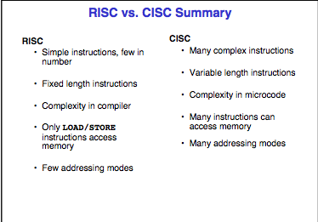
RISC VS CISC

Slide 53
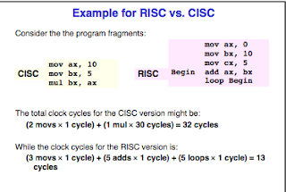
RISC VS CISC

Slide 54
RISC advantages
• A higher performance.
This is the tricky one! The previous two advantages are easy to accept, but in a world where higher performance had been sought through ever-increasing complexity.

Slide 55
RISC Drawbacks
With the passage of time, two drawbacks have come to light:
RISCs generally have poor code density compared with CISCs.
code density - Definition. The amount of space that an executable program takes up in memory.
Code density is important in mobile devices that contain a limited amount of memory.
RISCs don't execute x86 code.

Slide 56
Pipelines
A processor executes an individual instruction in a sequence of steps. A typical sequence might be:
1. Fetch the instruction from memory (fetch).
2. Decode it to see what sort of instruction it is (dec).
3. Access any operands that may be required from the register bank (reg).
4. Combine the operands to form the result or a memory address (ALU).
5. Access memory for a data operand, if necessary (mem).
6. Write the result back to the register bank (res).

Slide 57
RISC in retrospect
RISCs achieved their performance through:
• Pipelining.
Pipelining is the simplest form of concurrency to implement in a processor and
delivers around two to three times speed-up. A simple instruction set greatly simplifies
the design of the pipeline.
A high clock rate with single-cycle execution.

Slide 58
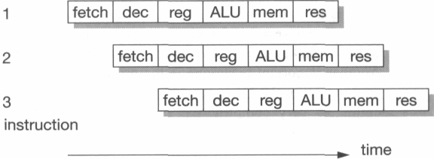
Pipeline hazards
It is relatively frequent in typical computer programs that the result from one instruction is used as an operand by the next instruction.
When this occurs the pipeline operation shown in Figure 1.13 breaks down, since the result of instruction 1 is not available at the time that instruction 2 collects its operands.
Instruction 2 must therefore stall until the result is available, giving the behaviour shown in Figure 1.14
This is a read-after-write pipeline hazard.

Slide 59
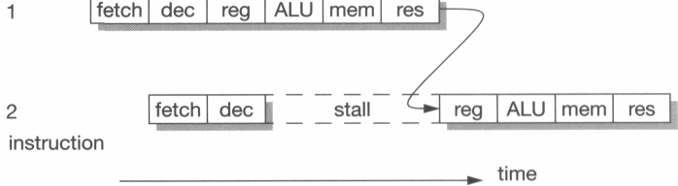
Pipeline hazards
Read-after-write pipeline hazard.

Slide 60
Pipeline hazards(Branch Instructions)
Branch instructions result in even worse pipeline behaviour since the fetch step of the following instruction is affected by the branch target computation and must therefore be deferred.
Unfortunately, subsequent fetches will be taking place while the branch is being decoded and before it has been recognized as a branch, so the fetched instructions may have to be discarded

Slide 61
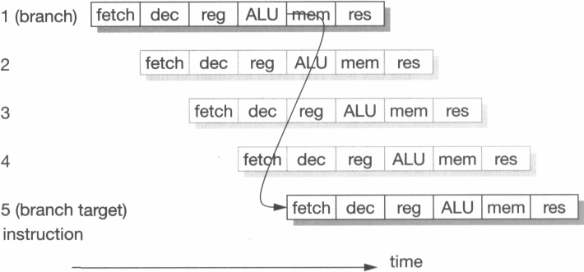
Pipeline hazards(Branch Instructions)
Pipelined branch behaviour.

